Slide 1
Android System Programming Introduction
By Chen Changhong(2018/1/24)

Slide 2
Agenda
Development Environment
Build AOSP
Android Makefile
System programming concepts
Android HAL
Smart Pointer(wp/sp)
Looper
Binder
Ashmem

Slide 3
Development environment
Windows
Android Studio
SDK/NDK
Running on Emulator or real hardware
Usually for Application development, Only can use provided APIs from SDK/NDK
Linux
AOSP(Android Open Source Project)
Running on Emulator or real hardware
Usually for system development

Slide 4
Build AOSP - 1
For Android 4.4
安装ubunut12.04
sudo apt-get git install git-core gnupg flex bison gperf build-essential zip curl zlib1g-dev gcc-multilib g++-multilib libc6-dev-i386 lib32ncurses5-dev x11proto-core-dev libx11-dev lib32z-dev ccache libgl1-mesa-dev libxml2-utils xsltproc unzip vim

Slide 5
Build AOSP - 2
- 安装Oracle JDK 1.6
* 不同的Android版本需要的JDK不同
cd /home/tv
chmod +x jdk-6u45-linux-x64.bin
./jdk-6u45-linux-x64.bin

Slide 6
Build AOSP - 3
- 获取repo
cd /home/tv
mkdir ~/bin
cd ~/bin/
wget https://storage-googleapis.proxy.ustclug.org/git-repo-downloads/repo --no-check-certificate
chmod +x repo

Slide 7
Build AOSP - 4
-设置PATH
export JAVA_HOME=/home/tv/jdk1.6.0_45
export PATH=$JAVA_HOME/bin:/home/tv/bin:$PATH
java -version确认JDK版本

Slide 8
Build AOSP - 5
- 下载aosp
http://mirrors.ustc.edu.cn/aosp-monthly/aosp-latest.tar
cd /home/tv
tar -xvf aosp-latest.tar

Slide 9
Build AOSP - 6
- 修改repo源url
vi aosp/.repo/manifests.git/config
url = git://mirrors.ustc.edu.cn/aosp/platform/manifest
- 同步代码
cd aosp
repo checkout -b android-4.4.2_r2
repo sync

Slide 10
Build AOSP - 7
设置编译环境变量
cat aosp/buildenv.sh
export OUT_DIR_COMMON_BASE=/home/tv/ANDROID_OUT
export USE_CCACHE=1
export CCACHE_DIR=/home/tv/ANDROID_CCACHE
prebuilts/misc/linux-x86/ccache/ccache -M 50G

Slide 11
Build AOSP - 8
- 开始编译
source buildenv.sh
source build/envsetup.sh
lunch
choose "1. aosp_arm-eng"
make -j4

Slide 12
Build AOSP - 9
- 运行emulator
emualtor &
- 连接emulator
adb shell

Slide 13
Build AOSP - 10
编译和执行程序
copy 程序hello目录到aosp/external
cd aosp/external/hello
mm
mm -B 重现编译
adb push ~/ANDROID_OUT/aosp/target/product/generic/system/bin/hello /data
adb shell /data/hello

Slide 14
Native Android Makefile
NDK installation
Android.mk
Application.mk
ndk-build
push and run

Slide 15
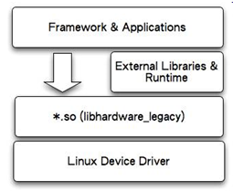
Android HAL

Slide 16
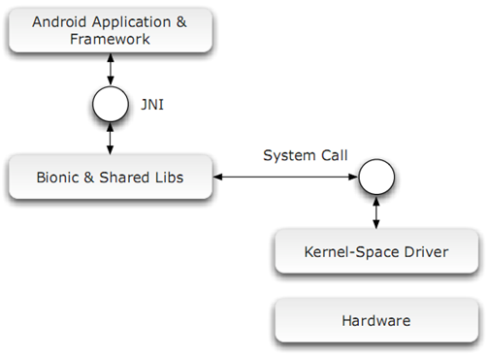
HAL - 1

Slide 17
HAL - 2
Hardware Abstraction Layer
Defines a standard interface for hardware vendors to implement
Typically built into shared library modules (.so )
Interface definition
hardware/libhardware/include/hardware/hardware.h
Two components
Modules
Devices
Example
https://github.com/lshain-android-source/hardware-libhardware/blob/master/modules/freg/freg.c

Slide 18
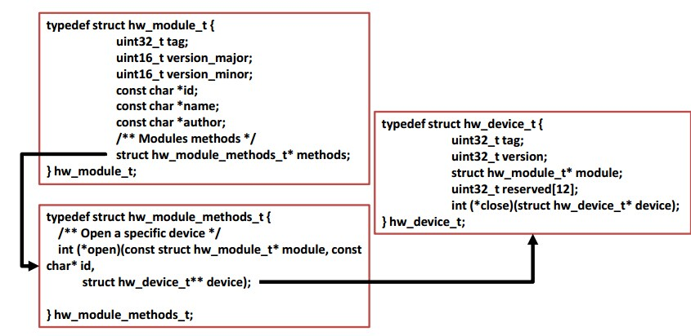
HAL - 3

Slide 19
HAL modules
A module represents your packaged HAL implementation
stored as a shared library (.so file)
hw_module_t
hw_module_methods_t
struct audio_module HAL_MODULE_INFO_SYM
http://androidxref.com/5.0.0_r2/xref/hardware/libhardware/include/hardware/tv_input.h#61

Slide 20
HAL Devices
Return by hw_module_t->open()
http://androidxref.com/5.0.0_r2/xref/hardware/libhardware/include/hardware/tv_input.h#61

Slide 21
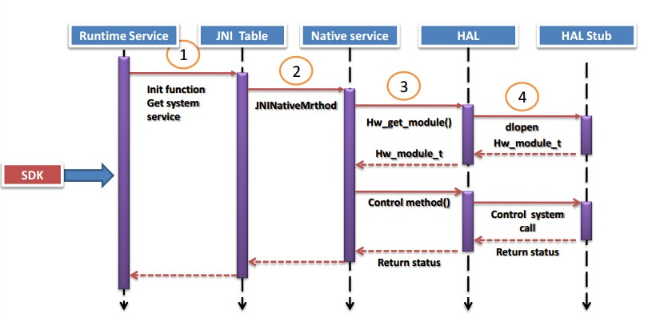
HAL Call

Slide 22
Smart Pointer
LightRefBase
轻量级引用计数
wp
强指针引用
sp
弱指针引用

Slide 23
Looper – 1
android为线程间异步消息通信提供的一种机制，利用Looper机制可以方便实现多线程编程时线程间的相互沟通
实现是利用消息队列的方式，为用户封装了一层API，用户不需要考虑互斥加锁的问题，方便用户的使用

Slide 24
Looper - 2
Looper
负责创建消息队列，并执行消息循环
Message Queue
消息队列，消息以链表形式组织。Message不是直接加入到MessageQueue，而是通过一个与该looper绑定的handler添加进来的
Message
消息格式
Handler
派发消息以及处理消息

Slide 25
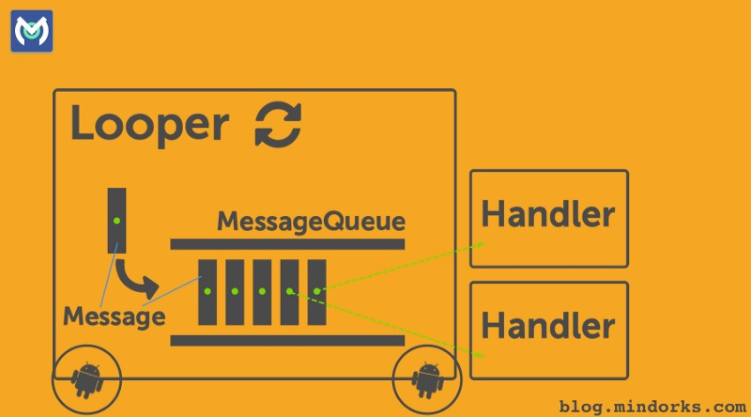
Looper - 3

Slide 26
IPC mechanism
GNU/Linux
Pipes
Shared Memory
Message Queue
Android
Binder

Slide 27
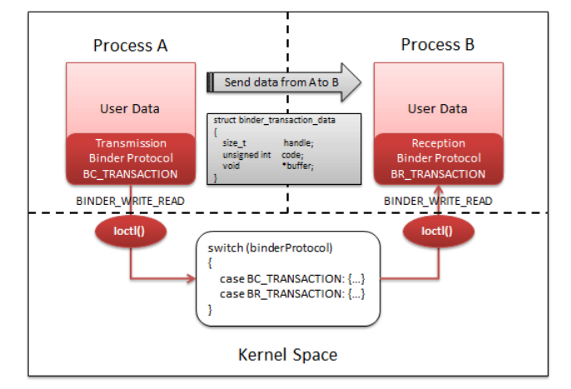
Binder
root@generic_x86_64:/dev # ls -l binder
crw-rw-rw- root root 10, 62 2018-01-23 06:39 binder

Slide 28
Binder - Example
ServiceManager
void addService(String name, IBinder service)
IBinder getService(String name)
> adb shell service list
startThreadPool()
启动Service Thread
joinThreadPool()
Wait thread exit

Slide 29
AIDL
Android Interface Definition Language
实现进程间通信，尤其是在涉及多进程并发情况下的进程间通信
interface BookManager {
List<Book> getBooks();
Book getBook();
int getBookCount();
}
https://www.jianshu.com/p/d1fac6ccee98

Slide 30
AShMem
Anonymous Shared Memory-Ashmem
APP端View视图的数据是传递SurfaceFlinger服务
数据是在两个进程间传递
Binder不适合这种数据量较大的通信

Slide 31
ASHMem vs Linux shmem
the ashmem memory dies when the process dies

Slide 32
ASHMem usage
Server
int fd = ashmem_create_region("SharedRegionName", size);
Client
int base_address = mmap(NULL, size, PROT_READ | PROT_WRITE, MAP_SHARED, fd, 0);

Slide 33
Q & A

